Slide 1
Module 1
Introduction

Slide 2
Content
Levels in Architecture
Virtual Machine
Evolution of Multi-Level Machines

Slide 3
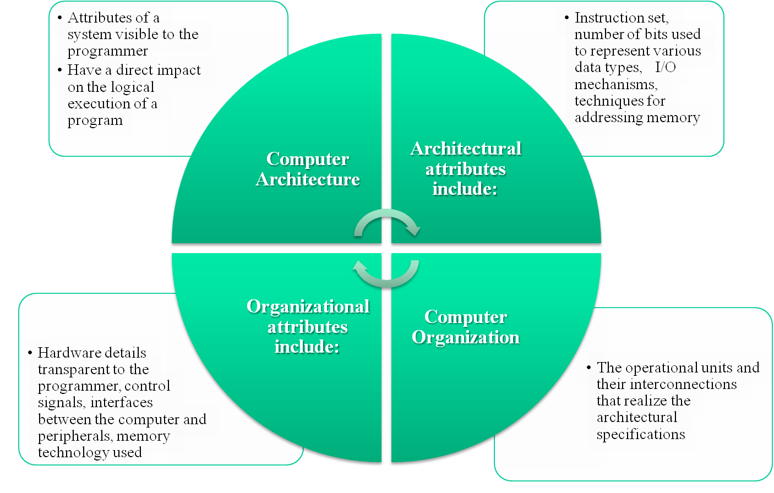
Computer Architecture &
Computer Organization
Notes:
In describing computers, a distinction is often made between computer architecture
and computer organization. Although it is difficult to give precise definitions
for these terms, a consensus exists about the general areas covered by each
(e.g., see [VRAN80], [SIEW82], and [BELL78a]); an interesting alternative view
is presented in [REDD76].
Computer architecture refers to those attributes of a system visible to a
programmer or, put another way, those attributes that have a direct impact on
the logical execution of a program. A term that is often used interchangeably with computer
architecture is instruction set architecture (ISA) . The ISA defines instruction
formats, instruction opcodes, registers, instruction and data memory; the effect of
executed instructions on the registers and memory; and an algorithm for controlling
instruction execution. Computer organization refers to the operational
units and their interconnections that realize the architectural specifications.
Examples of architectural attributes include the instruction set, the number of bits
used to represent various data types (e.g., numbers, characters), I/O mechanisms,
and techniques for addressing memory. Organizational attributes include those
hardware details transparent to the programmer, such as control signals; interfaces
between the computer and peripherals; and the memory technology used.
For example, it is an architectural design issue whether a computer will have
a multiply instruction. It is an organizational issue whether that instruction will
be implemented by a special multiply unit or by a mechanism that makes repeated
use of the add unit of the system. The organizational decision may be based on the
anticipated frequency of use of the multiply instruction, the relative speed of the two
approaches, and the cost and physical size of a special multiply unit.
Historically, and still today, the distinction between architecture and organization
has been an important one. Many computer manufacturers offer a family of
computer models, all with the same architecture but with differences in organization.
Consequently, the different models in the family have different price and performance
characteristics. Furthermore, a particular architecture may span many years and
encompass a number of different computer models, its organization changing with
changing technology.
© 2016 Pearson Education, Inc., Hoboken, NJ. All rights reserved.

Slide 4
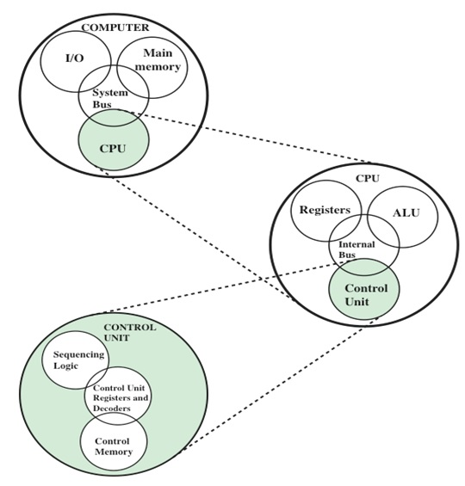
Structure
A Top-Down view of a Computer [1]

Slide 5
The Digital Computer
Machine to carry out instructions
  i.e., A program
Instructions are simple:
  Add numbers
  Check if a number is zero
  Copy data between memory locations
Primitive instructions in machine language

Slide 6
Structured Computer Organization
There is a large gap between what is convenient for people and what is convenient for computers
People want to do X, but computers can only do Y
  This leads to a problem
The goal of this course is to explain how this problem can be solved

Slide 7
Levels in architecture & Virtual Machine [2]
The problem can be resolved in 2 ways, both involve designing a new set of instructions(represented by a Language ‘L₁’) that is more convenient for people to use than the set of built-in machine instructions(Language L₀).
  The programs written in L₁ must be executed by the computer, which can only execute programs written in its machine language, L₀
The First Method of executing a program written in L₁ is to replace each instruction in it by an equivalent sequence of instructions in L₀

Slide 8
Method 1 … Contd.
The resulting program consists entirely of L₀ instructions
The computer then executes the new L₀ program instead of the old L₁ program
This technique is called Translation
The Second Method is to write a program in L₀ that takes programs in L₁ as input data and carries them out by examining each instruction in turn and executing the equivalent sequence of L₀ instructions directly.
  This does not require first generating a new program in L₀
This is called Interpretation
  Program that carries it out is called an interpreter.

Slide 9
Translation and Interpretation
Translation and interpretation are similar
  In both methods, the computer carries out instructions in L₁ by executing equivalent sequences of instructions in L₀.
The difference between two methods:
In translation, the entire L₁ program is first converted to an L₀ program, the L₁ program is thrown away, and then the new L₀ program is loaded into the computer’s memory and executed
  During execution, the newly generated L₀ program is running and in control of the computer.
In interpretation, after each L₁ instruction is examined and decoded, it is carried out immediately. No translated program is generated.
  Here, the interpreter is in control of the computer. To it, the L1 program is just data.
Both methods, or a combination of the two, are widely used.

Slide 10
Virtual Machine
Rather than thinking in terms of translation or interpretation, it is often simpler to imagine the existence of a hypothetical computer or virtual machine whose machine language is L₁
Let us call this virtual machine M1
  and let us call the machine corresponding to L₀ as M0
To make translation or interpretation more practical, the obvious approach is to invent still another set of instructions that is more people-oriented and less machine-oriented than L₁.
This third set also forms a language, which we will call L2 (and with virtual machine M2).
  People can write programs in L2 just as though a virtual machine with L2 as its machine language really existed.
  Such programs can be either translated to L1 or executed by an interpreter written in L1.

Slide 11
Virtual Machine
The invention of a whole series of languages, each one more convenient than its predecessors, can go on indefinitely until a suitable one is finally achieved.
Each language uses its predecessor as a basis, so we may view a computer using this technique as a series of layers or levels, one on top of another.
The bottommost language or level is the simplest and the topmost language or level is the most sophisticated.
Each Virtual machine has a machine language, consisting of all the instructions that the machine can execute.

Slide 12
A Multi-Level Machine [2]
Virtual machine Mn, with machine language Ln
Programs in Ln are either interpreted by an interpreter running on a lower machine, or are translated to the machine language of a lower machine
Level n
Level 3
Virtual machine M3, with machine language L₃
Virtual machine M2, with machine language L₂
Programs in L₂ are either interpreted by interpreters running on M1 or M0, or are translated to L₁ or L₀
Level 2
Level 1
Virtual machine M1, with machine language L₁
Programs in L₁ are either interpreted by interpreters running on M0, or are translated to L₀
Level 0
Virtual machine M0, with machine language L₀
Programs in L₀ can be directly executed by the electronic circuits

Slide 13
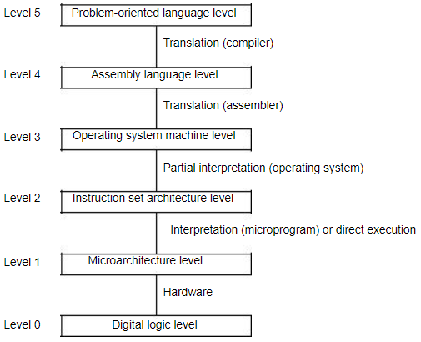
Contemporary Multilevel Machines
Figure: A six-level computer. The support method for each level is indicated below it (along with the name of the supporting program).

Slide 14
Evolution of Multilevel Machines [2]
Invention of microprogramming
Invention of operating system
Migration of functionality to microcode
Elimination of microprogramming

Slide 15
Evolution of Multilevel Machines [2]
Invention of microprogramming:
The first digital computers(in 1940s) had only two levels: the ISA level, in which all the programming was done, and the digital logic level, which executed these programs. The digital logic level’s circuits were complicated, difficult to understand and build, and unreliable.
In 1951, a three-level computer came into existence, in order to drastically simplify the hardware and thus reduce the number of (unreliable) vacuum tubes needed (Wilkes, 1951). This machine was to have a built-in, unchangeable interpreter (the microprogram), whose function was to execute ISA-level programs by interpretation.
Because the hardware would now only have to execute microprograms, which have a limited instruction set, instead of ISA-level programs, which have a much larger instruction set, fewer electronic circuits would be needed. Because electronic circuits were then made from vacuum tubes, such a simplification promised to reduce tube count and hence enhance reliability (i.e., the number of crashes per day).

Slide 16
Evolution of Multilevel Machines [2]
Invention of operating system:
In early years, most computers were ‘‘open shop,’’ which meant that the programmer had to operate the machine personally, with a deck of punched cards (an early input medium).
Around 1960 people tried to reduce the amount of wasted time by automating the operator’s job.
A program called an operating system was kept in the computer at all times. In subsequent years, operating systems became more and more sophisticated.
New instructions, facilities, and features were added to the ISA level until it began to take on the appearance of a new level. Some of this new level’s instructions were identical to the ISA-level instructions, but others, particularly input/output instructions, were completely different. The new instructions were often known as operating system macros or supervisor calls. The usual term now used is system call.

Slide 17
Evolution …Contd.
Migration of functionality to microcode:
Once microprogramming had become common (by 1970), designers realized that they could add new instructions by just extending the microprogram. This revelation led to a virtual explosion in machine instruction sets, such as:
Instructions for integer multiplication and division,
Floating-point arithmetic instructions,
Instructions for calling and returning from procedures etc.
Furthermore, once machine designers saw how easy it was to add new instructions, they began looking around for other features to add to their microprograms. A few examples of these additions included:
Features to speed up computations involving arrays (indexing and indirect addressing),
Features to permit programs to be moved in memory after they have started running (relocation facilities),
I/O interrupt signals, process switching, instructions for processing audio, image, and multimedia files etc. Numerous other features and facilities have been added over the years, usually for speeding up some particular activity.
.

Slide 18
Evolution …Contd.
Elimination of microprogramming:
Microprograms grew enormously during the golden years of microprogramming (1960s and 1970s). They also tended to get slower and slower as they acquired more bulk.
Finally, some researchers realized that by eliminating the microprogram, vastly reducing the instruction set, and having the remaining instructions be directly executed (i.e., hardware control of the ALU), machines could be speeded up. In a certain sense, computer design had come full circle, back to the way it was before Wilkes invented microprogramming in the first place.But the wheel is still turning. Modern processors still rely on microprogramming to translate complex instructions to internal microcode that can be executed directly on streamlined hardware.

Slide 19
References
[1]. Computer Organization and Architecture”, 10/e, by William Stallings, Pearson Education
[2]. Tanenbaum & Austin, Structured Computer Organization, 6th Edition, Pearson Education

Slide 20
Next Topic
Performance Evaluation

